Slide 1
Lesson Objective:
You will be able to analyze scenarios to identify examples of potential and kinetic energy.

Slide 2
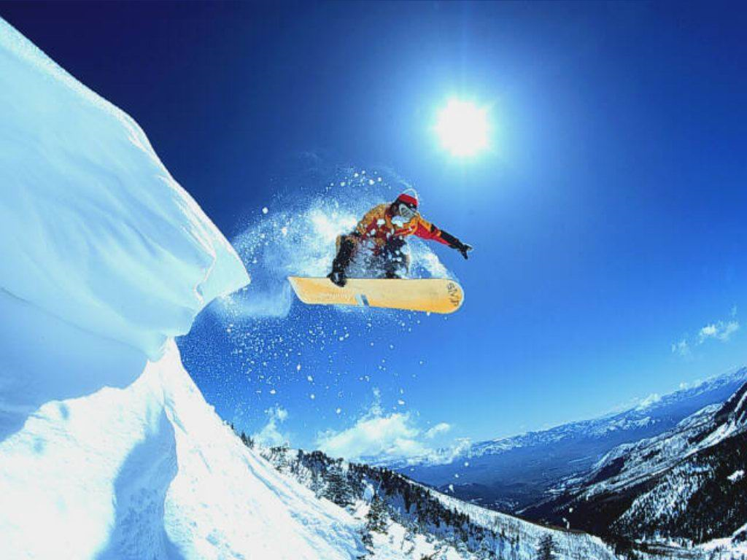
https://www.youtube.com/watch?v=kh29_SERH0Y

Slide 3
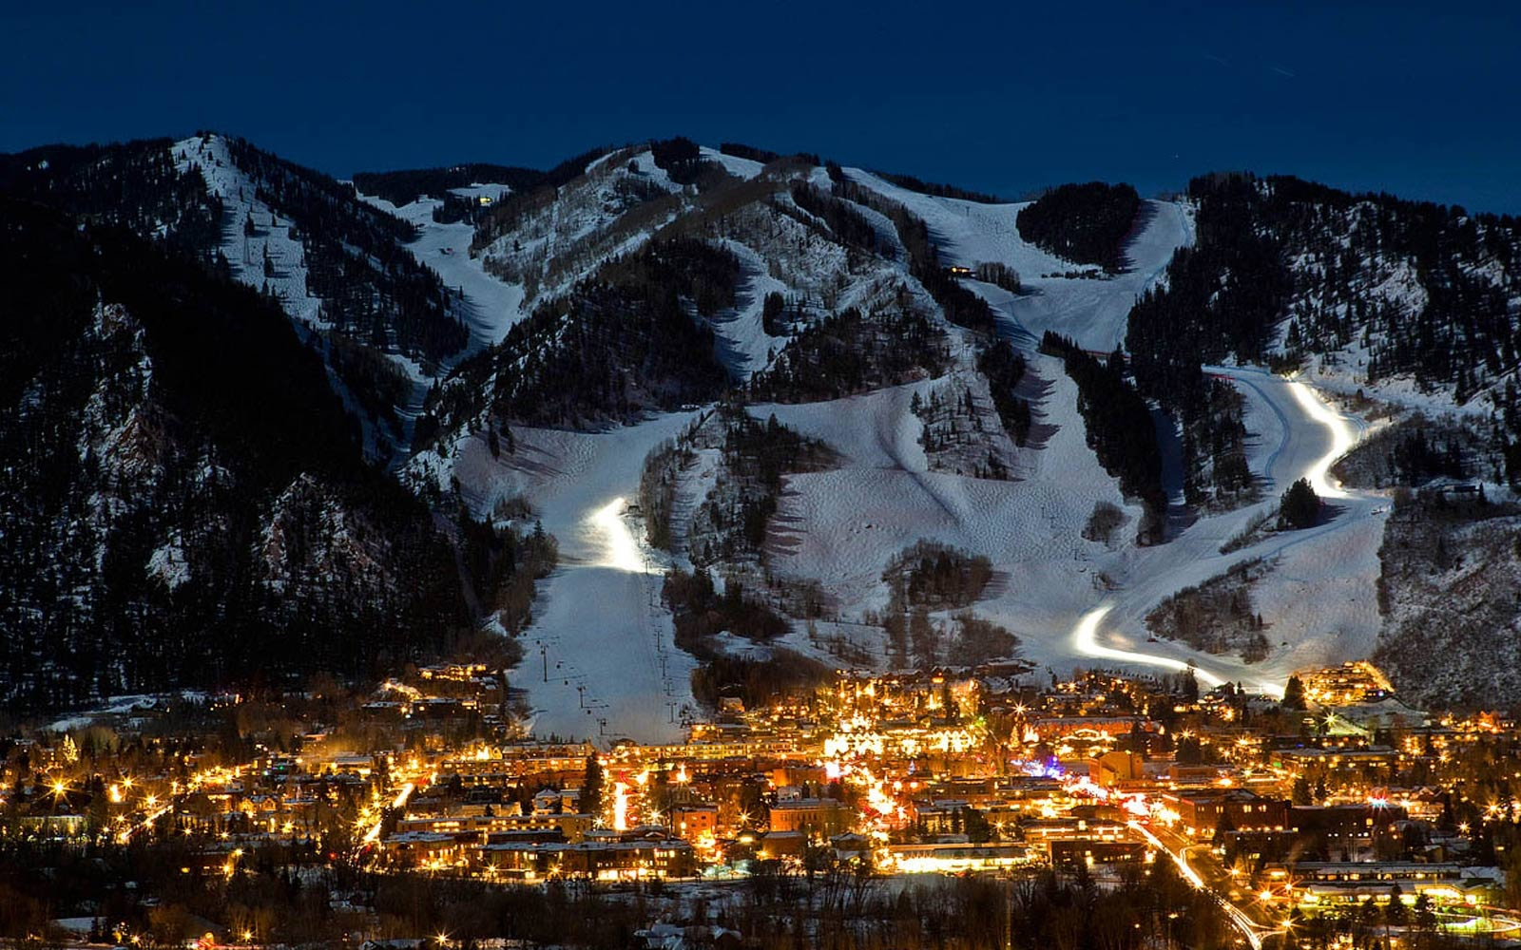

Slide 4
What is “Potential Energy”?

Slide 5
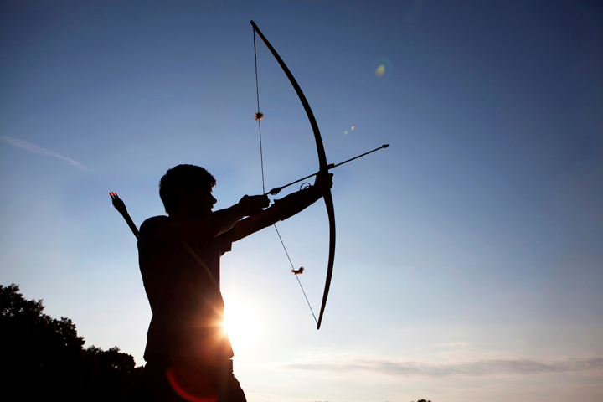
Potential Energy
Energy that is STORED in a system.
Similar to chemical energy.

Slide 6
Potential Energy

Slide 7
What is “Kinetic Energy”?

Slide 8
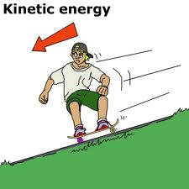
Kinetic Energy
Kinetic energy is energy of a moving object.
Similar to Mechanical energy.

Slide 9
Potential Energy
Kinetic Energy

Slide 10
3 examples of potential energy AND 3 examples of kinetic energy.

Slide 11
Potential Energy
Water behind a dam.
Snow before an avalanche.
A stretched rubber band.
A parked car.
An apple on a tree.

Slide 12
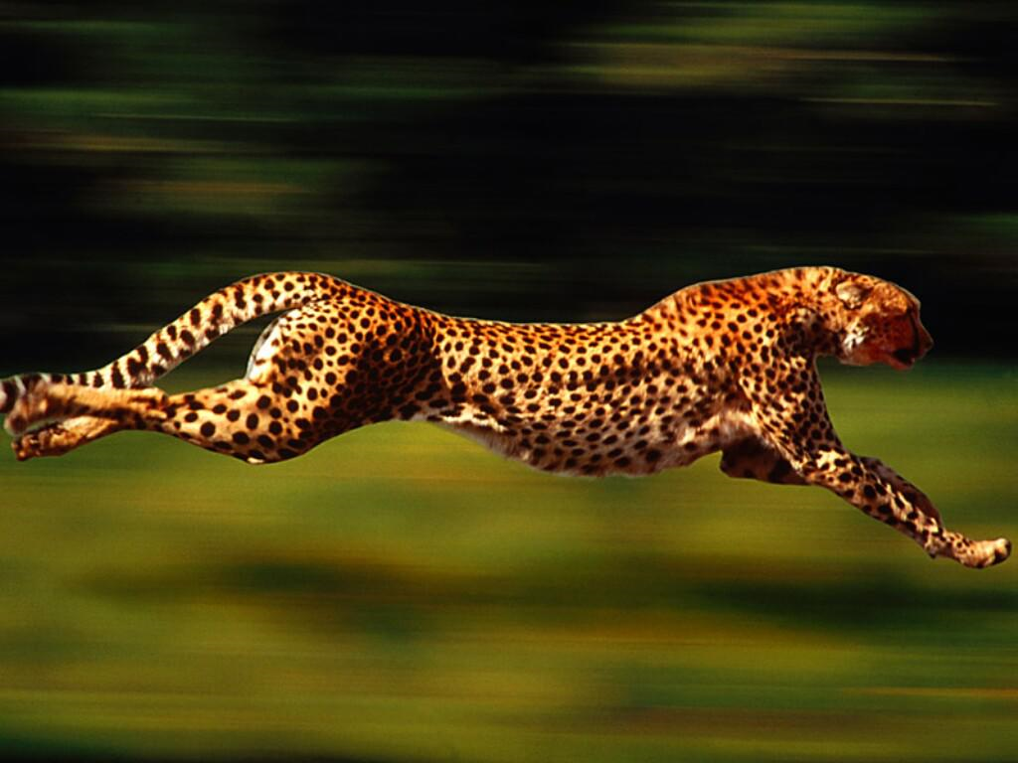
Kinetic Energy
An airplane flying.
Driving a car.
Running down a soccer field.
Throwing a football.
A fish swimming.
https://www.youtube.com/watch?v=dYx9wbCsl14

Slide 13
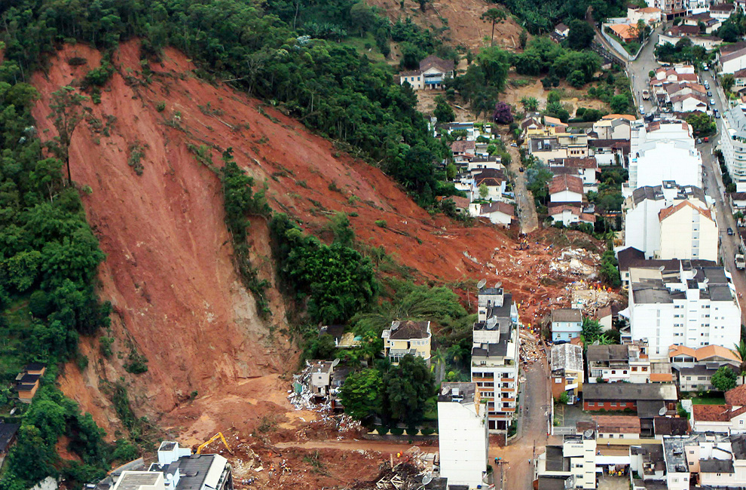

Slide 14
True or False? Standing on top of a mountain is an example of kinetic energy. True = 1 False = 2

Slide 15
True or False? Snowboarding down a mountain is an example of kinetic energy. True = 1 False = 2

Slide 16
Which is an example of potential energy? A = Skydiving B = Running in gym class C = Water behind a dam D = Snowboarding down a mountain

Slide 17
Which is an example of kinetic energy? A – A stretched rubber band. B – Swimming. C – A parked car. D – Standing on top of a hill.

Slide 18
Which is not an example of potential energy? A – An apple hanging on a tree. B – A child at the top of a slide. C – A soccer ball before you kick it. D – An airplane flying.

