Slide 1
Animal Adaptations
Adapted from: ericakt.net powerpoint

Slide 2
What is an Adaptation?
Anything that helps an organism survive in its environment is an adaptation.
It also refers to the ability of living things to adjust to different conditions within their environments.

Slide 3
Types of Adaptations
Physical Adaptations
Camouflage
Mimicry
Behavioral Adaptations
Migration
Hibernation

Slide 4
Physical Adaptations
A physical adaptation involves some part of an animal’s body.
These include: - Teeth
- Body Coverings
(hair, scales, feathers)
- Movement

Slide 5
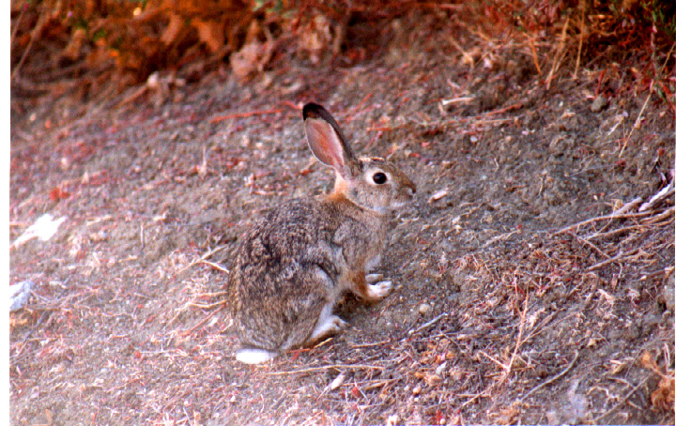
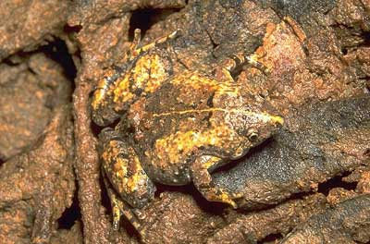
Camouflage
Coloration and protective resemblance allows an animal to blend into its environment.
Another word for this is camouflage. Their camouflage makes it hard for enemies to single out certain animals.

Slide 6
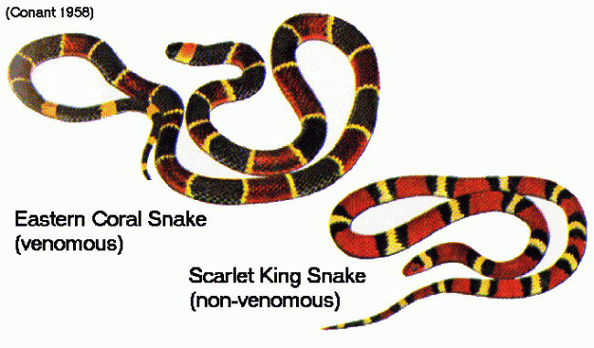
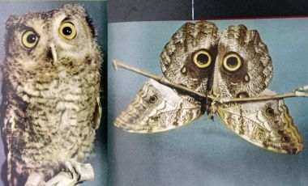
Mimicry
Mimicry allows one animal to look, sound, or act like another animal to fool predators into thinking its poisonous or dangerous.

Slide 7
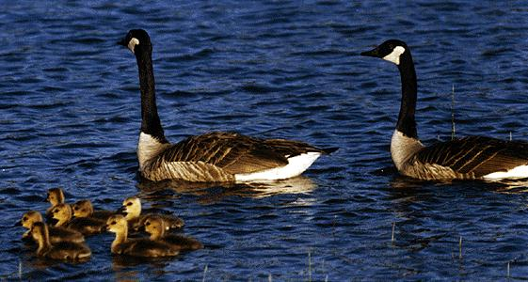
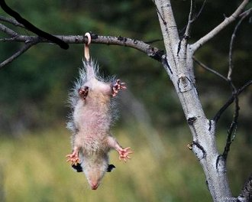
Behavioral Adaptations
Behavior adaptations include activities that help an animal survive.
These can be learned or instinctive.
- Social Behavior
- Behavior for protection

Slide 8
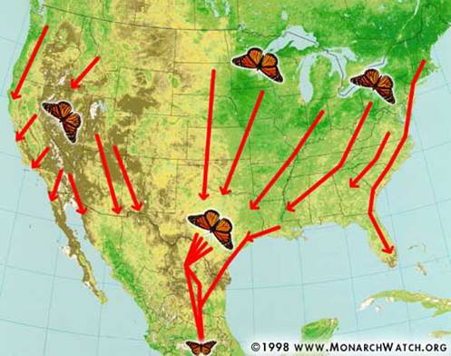
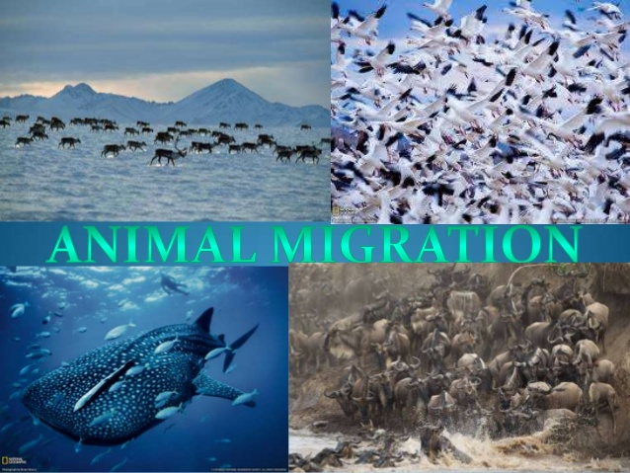
Migration
Migration involves an animal or group of animals to move from one region to another and then back again.
Animals migrate for different reasons.
Better climate
Better food
Safe place to live
Safe place to raise young
Go back to the place they were born

Slide 9
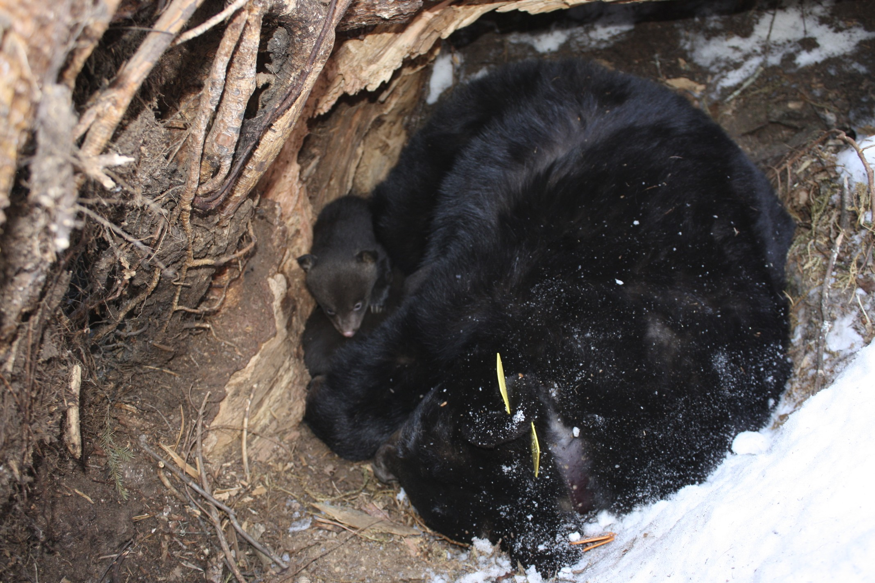
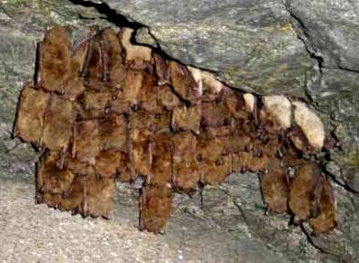
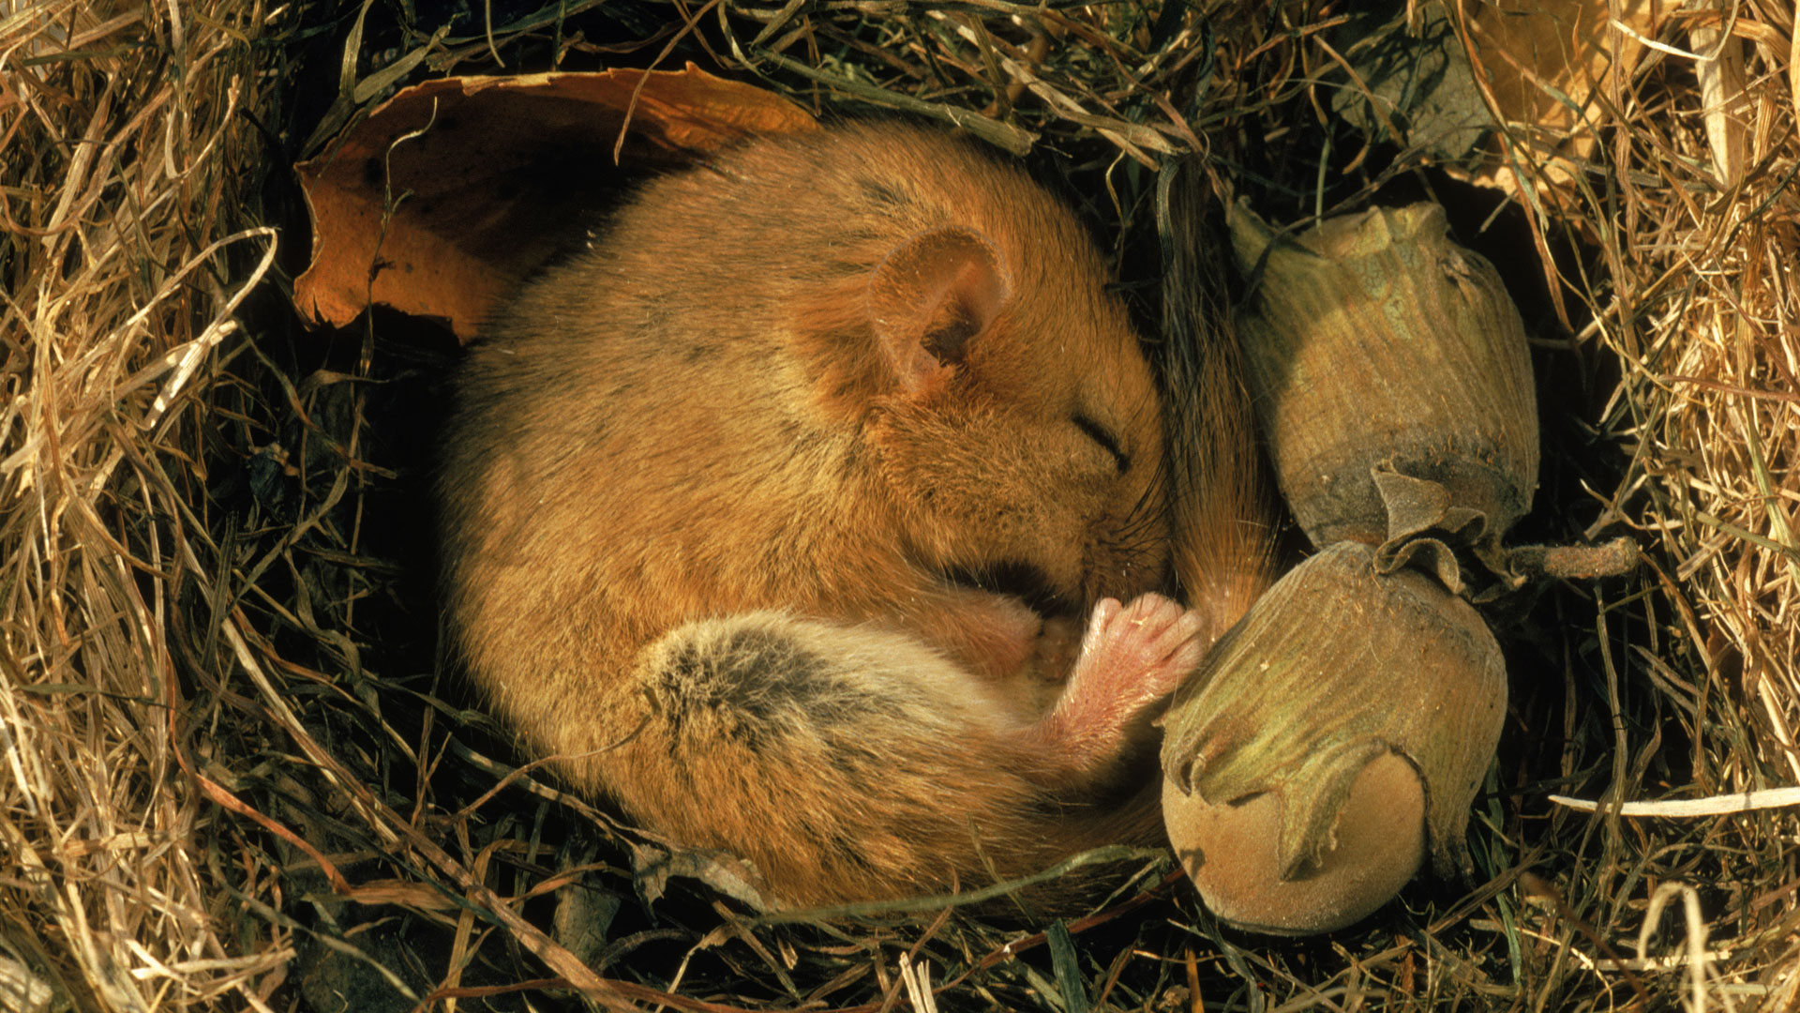
Hibernation
Hibernation is a deep sleep in which animal’s body temperature drops and body activities such as their heart rate and breathing are slowed to conserve energy.

